Slide 1
JavaScript Tutorial
Prashanth Jaligama

Slide 2
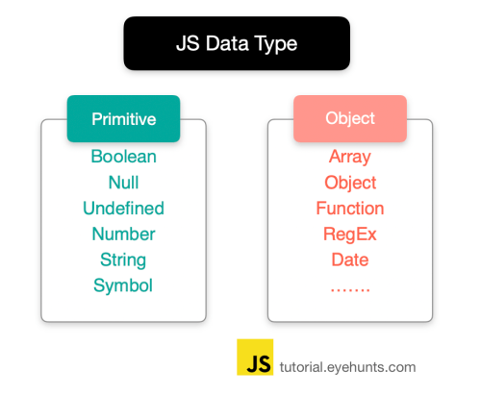
More on Types
typeof => [undefined, boolean, string, number, object, function]
NaN – special numeric value shot for not a number – isNAN()
Number() – convert to number
String() – convert to string
toString() – on any Object
Strings – single quotes vs double quotes
Primitive types are call by value
No Block Level scoping

Slide 3
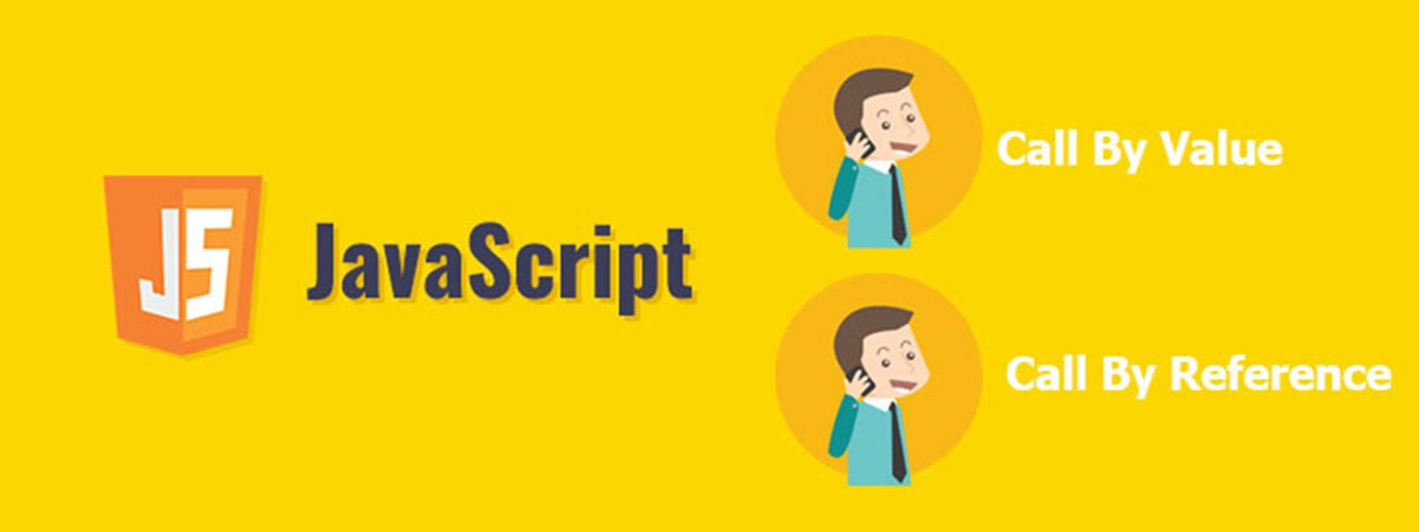
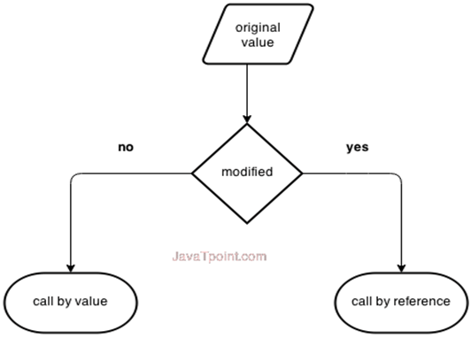
Object Type
Object – non primitive type
Created by new Object()
Can have dynamic property
Object types are Call by reference

Slide 4
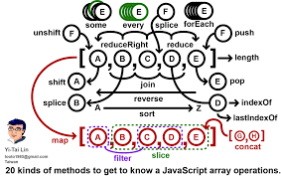
arrays
Also reference types
Instanceof Array check
toString, length, push, pop,
reverse, sort, join, indexof
forEach, map, some, filter, every
reduce, reduceRight
Can store any type of data
Ex: [1, “hello”, false, 3, obj ]

Slide 5
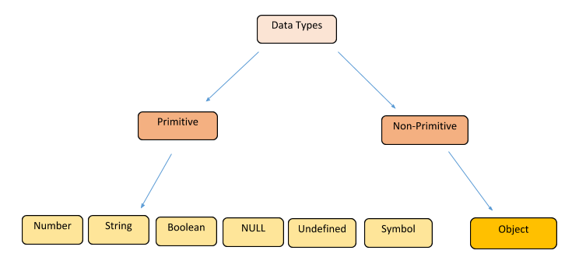
JavaScript Types
Data Types
Loosely typed
Can hold any type of data
var
undefined
null
Operators

Slide 6

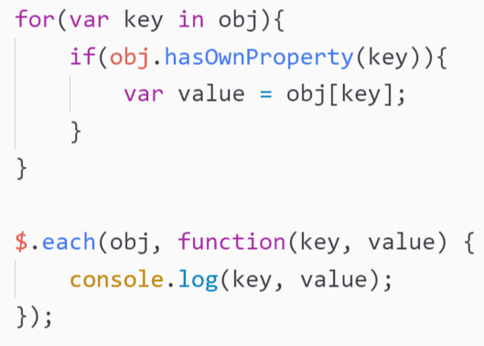
JavaScript Conditional and loops
If else
switch
for statement
for-in
for-each
for-of (ES6)
while loops
do-while
continue
break

Slide 7

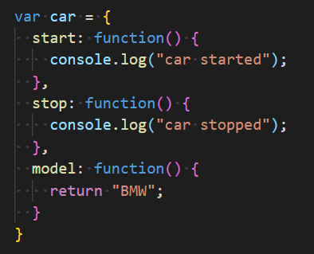

JavaScript functions
Case sensitive names
function keyword
Arguments
No Overloading, arguments are optional
Return statement (optional)
Types of declaring functions
function keyword
Inside a scope
ES6 functions

Slide 8

Coding Exercise
Ex-1. Write JS code for Hello World
Ex-2. Write JS code for adding two numbers
Ex-3. Write JS code for validating given numbers for digits
Ex-4. display addition, subtraction, division and multiplication of two given numbers
Ex-5. find reverse of a given sentence by reversing only words
“Hello World” ➔ “dlroW olleH”
“Sunday is Holiday” ➔ “adiloH si yaduuS”
Ex-6. Write a JavaScript to replace each character of a given string by the next one in the English alphabet. Note: 'a' will be replace by 'b' or 'z' would be replaced by 'a'. Types of declaring functions

Slide 9
Thank you
Reference
https://books.goalkicker.com/JavaScriptBook/

